Slide 1
Strengthening Rural Institutions as Drivers of Women's Economic Empowerment and Climate Resilience
Impact: To Increase food production, incomes, and resilient livelihoods of 3 million farmers, 66% of whom are women, in the 45 rural counties in Kenya
Rural women need a range of tailored, climate-smart agricultural solutions to not only adapt, but thrive in the face of climate change and help build more resilient food systems. Equipped with the right tools, rural women can drive increases in food production, ensure household nutrition, and contribute to mitigation efforts.
New technologies have the potential to deliver climate-smart financial and non-financial solutions to rural women at scale. By combining digital data, digital financial services, mobile channels, and platform approaches with in-person support and expertise, innovative business models are making it easier for partners to reach women at the last-mile, while addressing their mobility, time, and privacy concerns.

Slide 2
THE PROJECT
The project revolves around the Women's Economic Empowerment (WEE) initiative, with a strong focus on increasing food production, empowering women, improving rural livelihoods, and enhancing access to financial and non-financial services across 45 counties in Kenya.
The key mechanisms for change are:
Increase rural women’s use of financial and non-financial services, leveraging the national network of digitized credit and financial data warehouse
Strengthen access to markets through digitized climate-smart agtechs and agribusinesses
Ensure integrated service provision that includes access to inputs, information, extension and capacity building, and digital technology to enhance agricultural production

Slide 3
CHALLENGES
Challenges currently faced Include
Data distribution, Data model flexibility and scalability
TheUI/UX of the dashboard makes using it difficult. There is a lack of data pre-processing, slow speed, non-real-time data.
Heavy, manual process that is prone to errors

Slide 4
Proposed solution architecture
Data Flow: Build a streamlined clear process for data ingestion form various sources using Extract Load Transform (ELT) Architecture to the target which is the data warehouse or lake
Tools and Technologies: Transform the data in the warehouse and write it back and make it ready for AI/ML To generate actionable insights on the dashboard and also revise the visuals to include more data driven KPIs to aid data driven decision making
Follow a modular architecture where different data pipelines (input access, market access, insurance) feed into a central data repository (Warehouse).
Leverage the use of ELT processes in the architecture for data pre-processing before it's consumed by dashboards, ensuring clean, harmonized data.
A dashboard Design your Power BI dashboards to be fast and user-friendly by simplifying navigation, reducing the number of visuals, and ensuring that complex calculations are done outside the report to speed up load times and include bias-free insights.
Microservices & Event-Driven Architecture: Organize your system into separate services that can scale independently, and use tools like Kafka to manage data flow between them.
CI/CD & Error Handling: Leverage Azure DevOps to automate testing and deployment in Power BI, ensuring that reports are free of errors and updates are seamlessly rolled out.

Slide 5
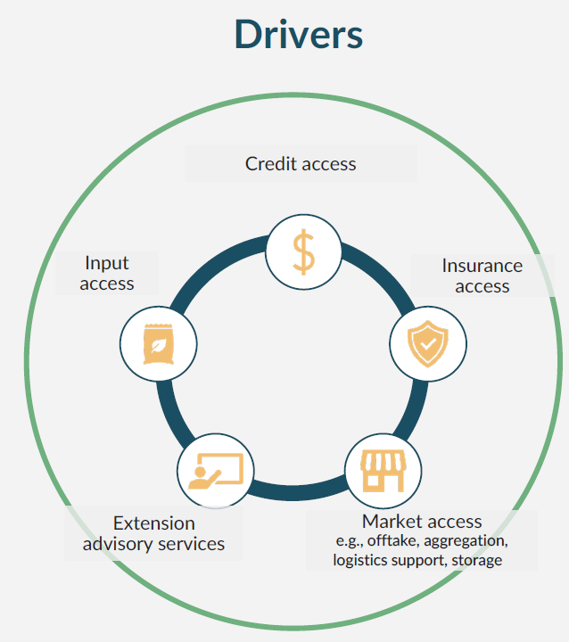
Sample actionable insights to FACILITATE DATA DRIVEN DECISION MAKING AS A FACTOR OF DRIVERS
Input:
In Baringo County, women farmers use lower levels of improved seeds, inorganic fertilizer, and extension services on their plots than men equating to over 60% of the gender gap in agricultural productivity in the county.
Insurance:
In Kakamega, farmers who purchase insurance are more likely to use inputs compared to those relying on savings to manage risk, this results in more yield with better way to cope with food insecurity
Market:
Women sold less than 15 percent of their milk to collection centers, traders, village markets, or other channels that required delivery outside their homes.
In the Narok town, livestock traders offer women lower prices than men. They have the information and networks to monitor market prices in the region.
Among tomato growers in Kimilili, women farmers harvested tomatoes over a longer period of time.

Slide 6
Sample actionable insights to FACILITATE DATA DRIVEN DECISION MAKING AS A FACTOR OF DRIVERS
Extension Advisory Services:
Women farmers receive only 5 percent of overall agricultural extension services
In Kiambu, Women farmers with access to information sold maize at an average price per kilogram 12 percent higher than farmers without information.
Credit Access:
Access to credit among women farmers positively influenced their planting dates in response to drought and relocation from food-prone areas as targeted adaptation measures.
Women farmers with access to credit facilities, reported more farm yield comparted to the last quarter

Slide 7
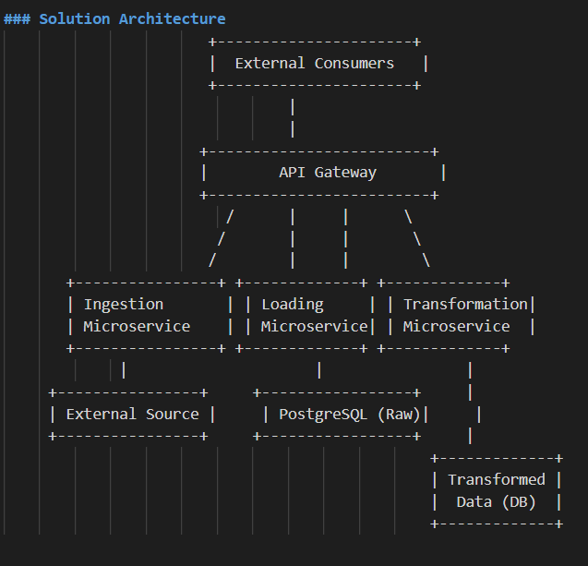
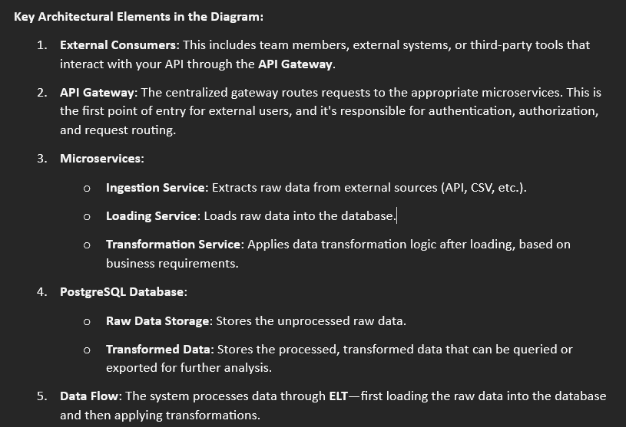
ELT SOLUTIONS ARCHITECTURE

Slide 8
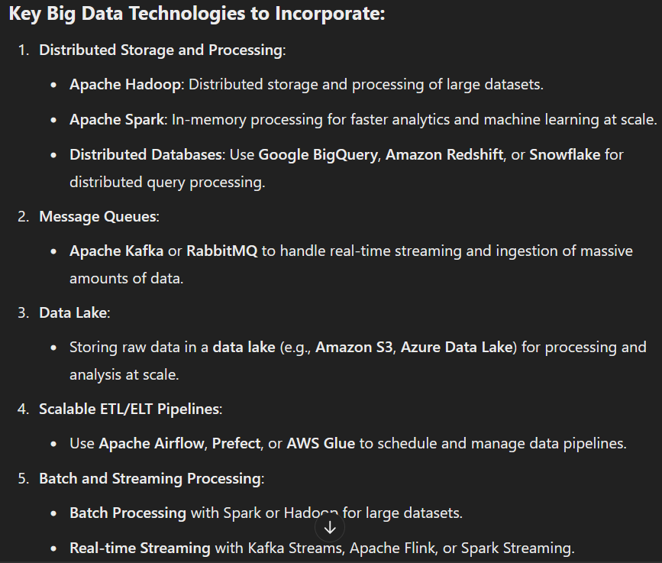
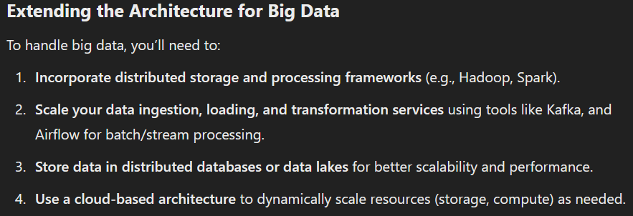
SOLUTIONS ARCHITECTURE leveraging on big data tools

Slide 9
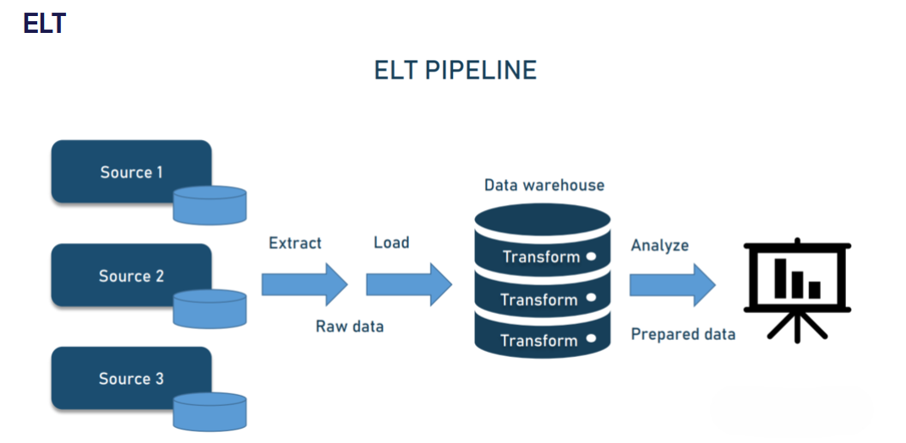
EXTRACT LOAD TRANSFORM(ELT) DATA PIPELINE ARCHITECTURE

